Slide 1

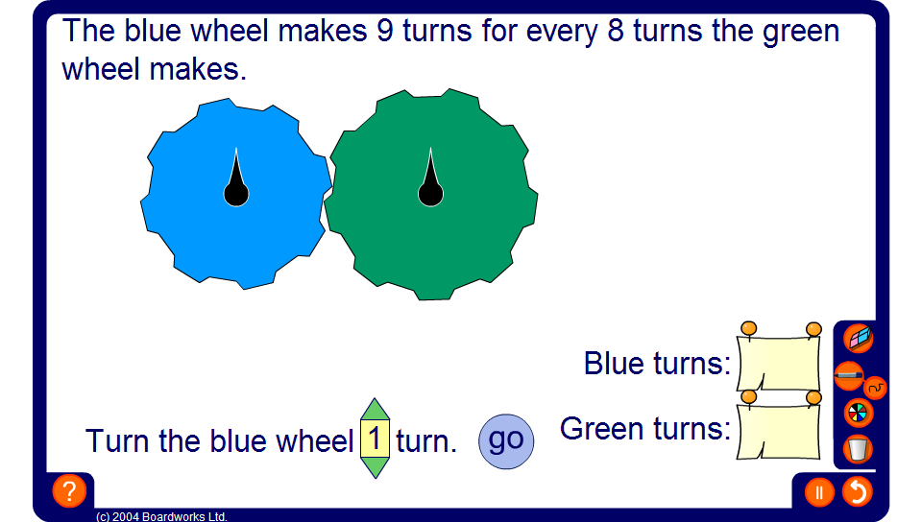

Cog wheels
Notes:
Introduce the problem by asking pupils how many turns the green wheel will go through for every complete turn of the blue wheel. Establish that if the blue wheel is bigger than the green wheel, this number will be greater than 1. If the blue wheel is smaller than the green wheel, this number will be less than 1.
Once this number has been found use it to work out the number of turns the green wheel will go through for any given whole number of turns of the blue wheel.

